Slide 1

Simulation of fast-ion-driven MHD modes in tokamak plasmas
Youjun Hu (胡友俊)*
Email: yjhu@ipp.cas.cn
Webpage: http://theory.ipp.ac.cn/~yj
6th Sino-Danish Autumn School on Fusion Plasma Physics and Technology, 2015-09-16,Hefei, China
*Institute of plasma physics, Chinese Academy of Sciences, Hefei, China

Slide 2
Outline/Summary
Introduction
Modeling of fast ions: Kinetic theory
Modeling of main plasmas: MHD theory
Kinetic-MHD hybrid model
Examples of fast-ion-driven MHD modes: Alfven eigenmodes

Slide 3
Auxiliary-heating/burning plasmas are MHD+EPs hybrid system
In addition to thermal ions and electrons, plasmas often contain superthermal particles=“energetic particles (EPs)”=“fast particles”
Source of EPs: NBI/rf heating, nuclear reactions
Highly energetic ( ): EAST NBI 50-80keV, alpha particles 3.5MeV, Runaway electrons ~MeV
Low density ( typically 1/30 of the ion number density)
Comparable pressure (typically 1/5 of thermal pressure for EAST NBI plasmas)

Slide 4
Roles of Fast Ions in Tokamak Plasmas
Main role:
Heat plasmas via Coulomb collision
Side effects:
Stabilize /Destabilize various MHD modes via wave-particle resonance
Redistribution/loss of fast ions can degrade plasma heating, and/or damage the first wall.

Slide 5
Velocity distribution of fast ions is usually non-Maxwellian
Velocity distribution of main plasma is approximately maxwellian (thermal plasma)
Velocity distribution of fast ions is usually non-Maxwellian, with an effective temperature much larger than the thermal temperature
Typical velocity distribution of NBI fast ions/Alpha-particles is the so-called “slowing-down” distribution:
where is the critical velocity for which the collisional friction of fast ions with thermal ions and electrons is equal.

Slide 6
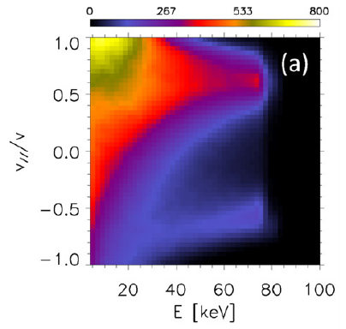
Distribution of NBI fast ions is anisotropic in velocity space
Alpha particles is isotropic in velocity space.
However, fast ions generated by NBI are anisotropic in velocity space
Distribution of NBI fast ions in space by NUBEAM simulation (Todo et al., Nucl. Fusion 54 (2014)

Slide 7
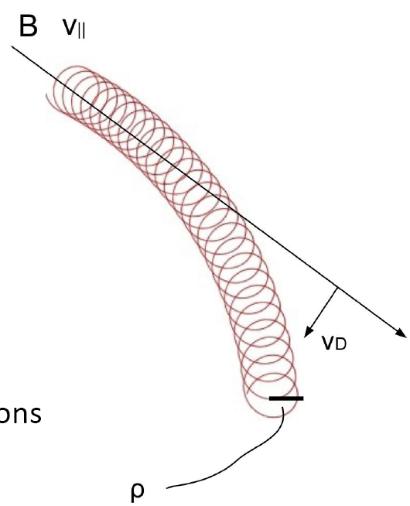
Wave-particle resonance is an important physics for the interaction of fast ions with thermal plasmas
Thermal plasmas can be described by MHD theory
Wave-particle resonance is not correctly treated in fluid theory
Kinetic equation is needed to describe the resonant interaction of fast ions with thermal plasmas
For low frequency ( ) phenomena, the guiding-center approximation is valid and useful for describing the motion of fast ions.

Slide 8
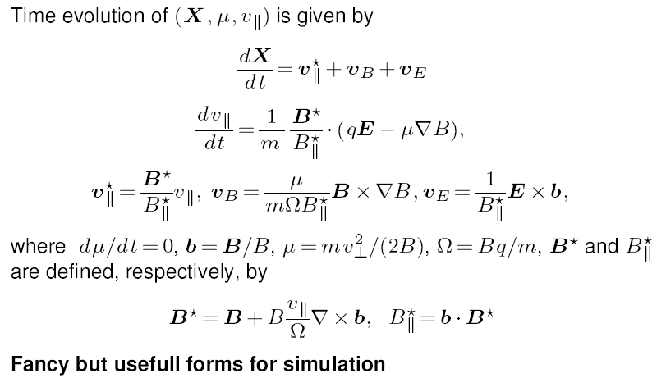
Equations of motion of guiding center

Slide 9
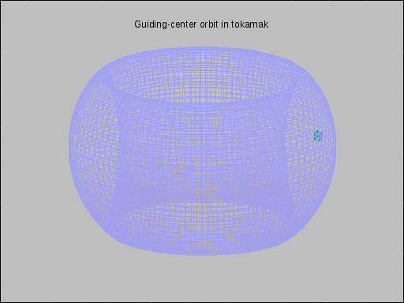
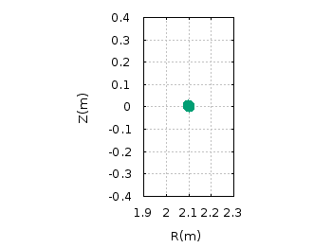
Motion of guiding-center of fast ions in Tokamak
Poloidal motion (bounce/circulating)
Toroidal motion (procession)
For trapped ions, the period of poloidal motion is usually shorter than that of toroidal motion

Slide 10
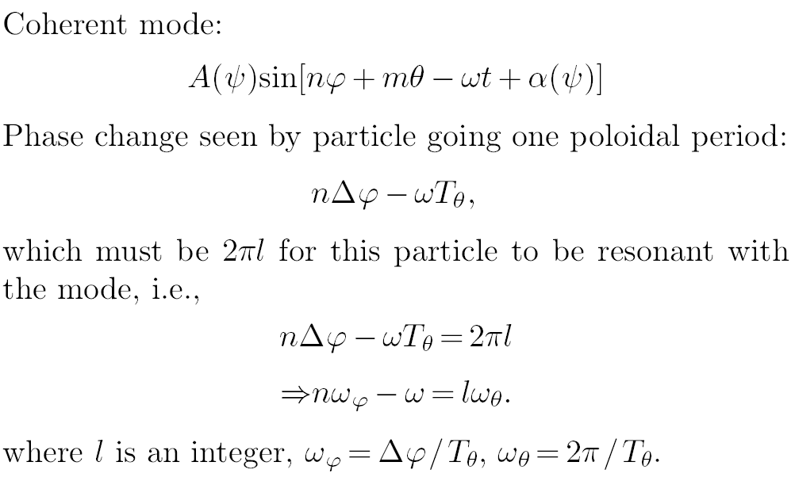
Resonance condition of fast ions with coherent modes

Slide 11
Special case: Resonance of strongly circulating fast ions with Toroidal Aflven eigenmode (TAE)
The poloidal period of a strongly circulating fast ions:
The poloidal angular frequency
Toroidal angular frequency
The frequency and radial location of TAE are approximately given by
Using these in the resonance condition, we obtain
for different values of

Slide 12
Resonance condition only provide necessary condition for efficient energy exchange, the actual energy transfer is determined by the distribution of fast ions and the waves
The actual energy transfer between fast ions and waves needs detailed numerical calculation,
but there exist simple formula to help understanding:
Usually damping
May be driving

Slide 13
A variety of collective instabilities, ranging from 10 Hz up to 10^9 Hz, can be driven by fast ions
According to the different resonance conditions, MHD modes driven by fast ions can be categorized into two classes:
Low frequency instabilities, such as fishbone/internal kink, associated the resonance between the mode frequency and the toroidal precession frequency of the fast ions;
(2) Higher frequency instabilities, such as various Alfven gap modes (TAE, EAE, NAE), associated with the resonance with the poloidal transit/bounce frequency of fast ions.

Slide 14
Fast-ion-driven modes are important because they transport fast ions and/or provide valuable information of the main plasmas
Modes excited by the fast ions are of interest because:
(1) They transport fast ions
(2) they provide valuable information of the main plasma
(A successful use of the latter is the so-called MHD spectrum, which uses the property of RSAE to infer the information of the safety factor profile.)
Almost all MHD modes have the possibility of interacting with fast ions.
The modes driven by fast ions themselves are especially effective in causing anomalous transport of the fast ions (e.g. Fishbone and Alfven eigenmodes).

Slide 15
Fast ions transport level is usually as low as the neoclassical level
Diffusion coefficient of fast ions is comparable to the neoclassical level and ten times smaller than the typical thermal ion transport.
The low transport level may be due to the orbit averaging of small scale plasma turbulence over the large orbits of the fast ions.
This transport reduction mechanism could, however, be less effective in larger tokamaks if the turbulence size scale increases with machine size.
The “anomalous” transport of fast ions is usually due to MHD modes such as fishbones and variosu Alfven eigenmodes.

Slide 16
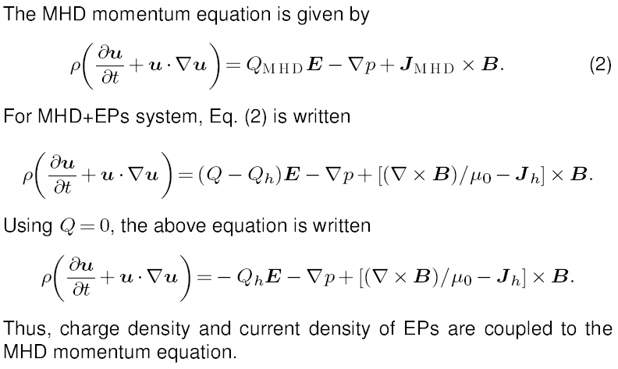
Coupling of MHD and EPs is via the charge and current density of EPs in the momentum equation

Slide 17
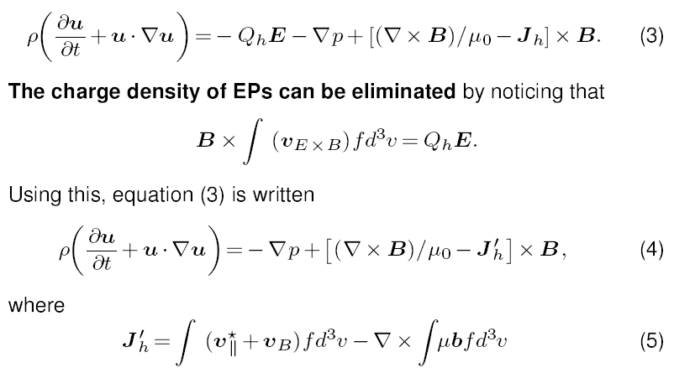
Further simplification of momentum equations

Slide 18
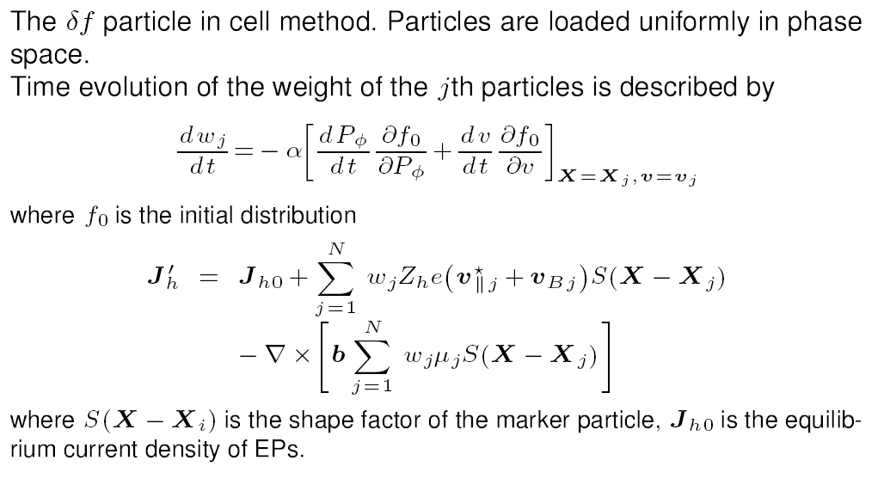
Particle-in-cell (PIC) method is used to calculate the current density of fast ions

Slide 19
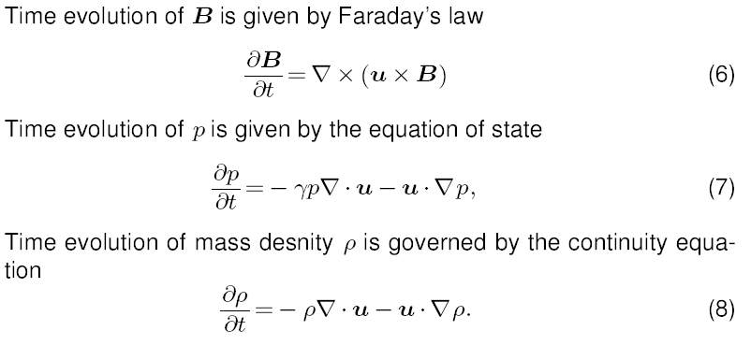
Other MHD equations are not changed by fast ions

Slide 20
Numerical methods for EP+MHD hybrid systems
MHD equations are treated in the cylindrical coordinates (R phi,Z) using 4th central difference schemes
Fast ions orbits are following by 4th Runge-Kutta integrator.
Current of fast ions are calculated by gyrokinetic PIC method
An implement of Kinetic-MHD hybrid model:
MEGA code, developed by Y. Todo et al, NIFS, Japan

Slide 21
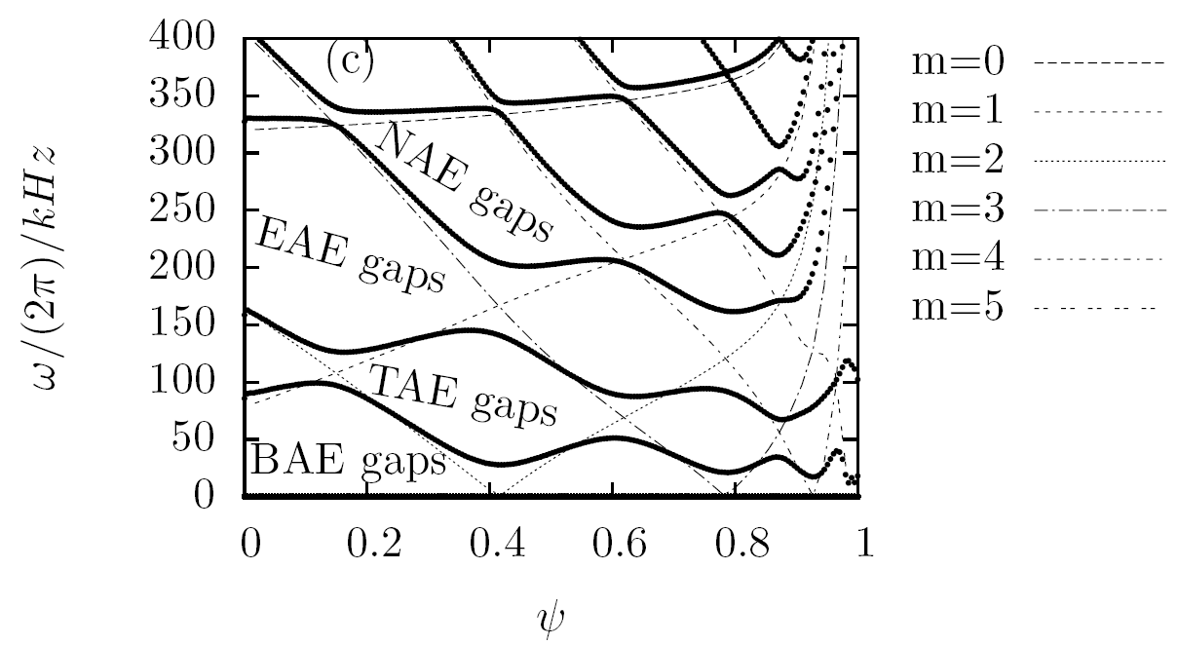
Alfven continua provide the approximate frequency and radial location of various Alfven eigenmodes
Gaps formed due to toroidal coupling (in cylindrical geometry, there are no gaps)
Cylindrical continua
TAE gap due to coupling of m and m+1
EAE gap due to coupling of m and m+2
Toroidal continua

Slide 22
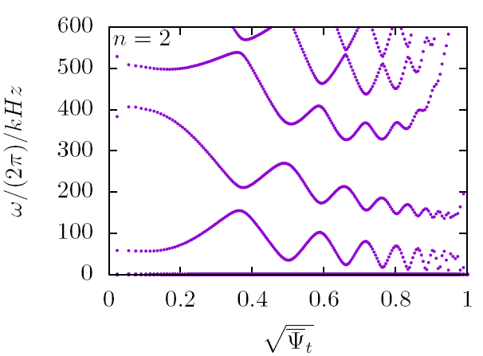
Alfven eigenmodes localize near the gap tips, other modes may intersect the continuua.
NAE
EAE
KTAE
TAE
EPM
Alfven continua for EAST #51063@4.5s, Equilibrium reconstructed by J. Qian

Slide 23
A simulation example:
fast-ion-driven Alfven eigenmodes
on EAST tokamak

Slide 24
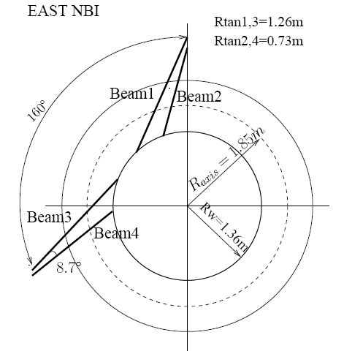
Neutral Beam injection (NBI) on EAST
4 beams, 2MW/beam
Particle energy: 50-80keV

Slide 25
Neutral particles from NBI are ionized to generate fast ions
NBI neutral particles ionize in plasma, generating fast ions.
The power deposition and distribution of fast ions in phase space can be calculated by using NUBEAM.
Before thermalization, fast ions interact with bulk plasma, with the possibility of exciting MHD modes.

Slide 26
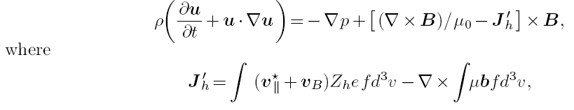
Kinetic MHD hybrid model and code
MHD momentum equation with EPs effects
(current coupling):
MEGA code:
developed by Y. Todo et al, NIFS
uses cylindrical coordinates to solve the full MHD equations in toroidal geometry
EPs are treated by gyrokinetic PIC method

Slide 27
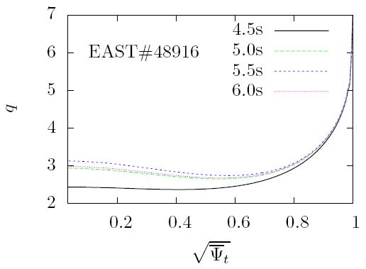
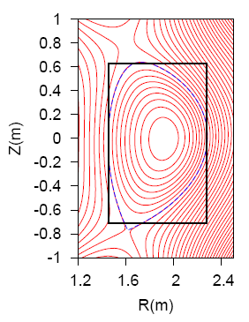
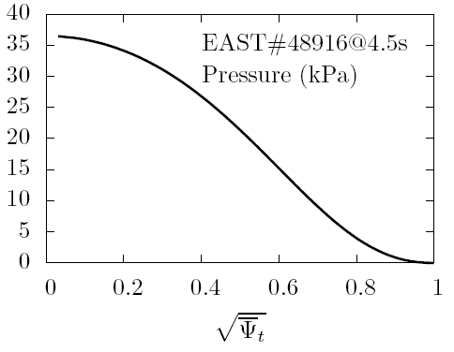
Equilibrium of EAST#48916@4.5s

Slide 28
Initial/boundary conditions
Random magnetic perturbation
Fixed zero boundary condition
Fast ions are lossed when reaching LCFS
Fast ions beta:
Distribution of Fast ions:

Slide 29
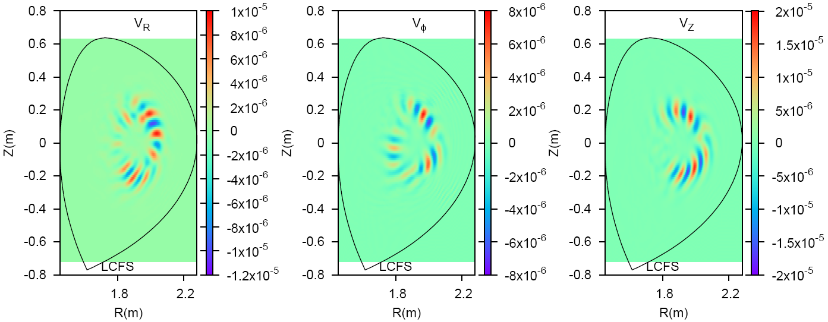
Cotour of perturbation at t=0.25ms

Slide 30
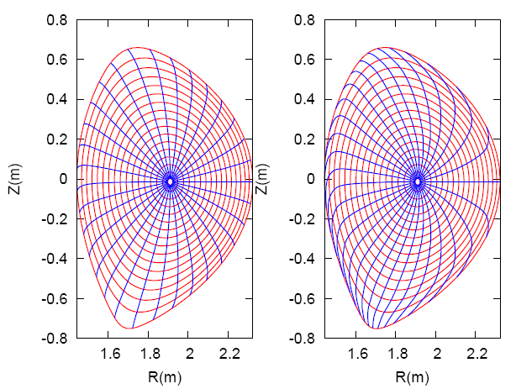
Magnetic coordinates are useful in analyzing and understanding the modes found in simulations
Choices of Poloidal angle
Equal-arc poloidal angle
Straight-field-line poloidal angle

Slide 31
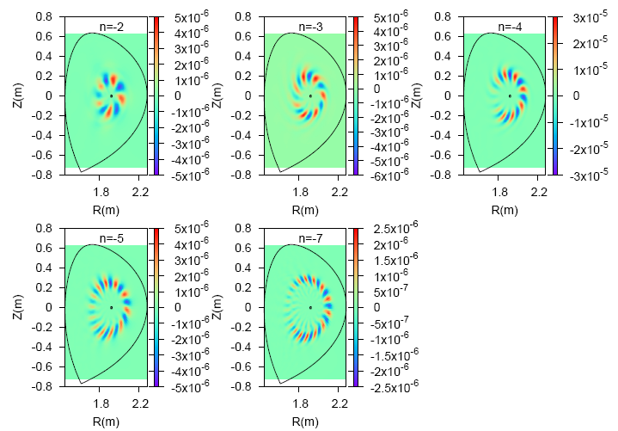
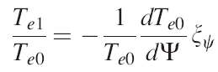
Simulation of Alfven eigenmodes in EAST48916@4.5s
Simulations using MEGA code
Contour of radial plasma displacement
Can be compared with ECEI diagnostic

Slide 32
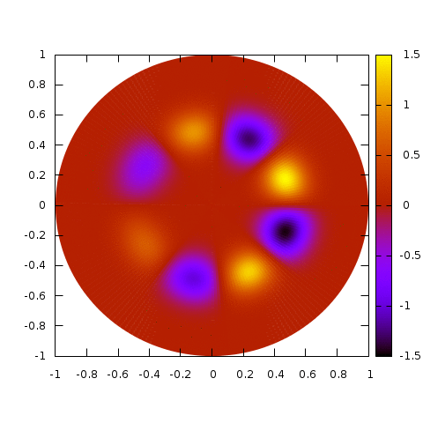
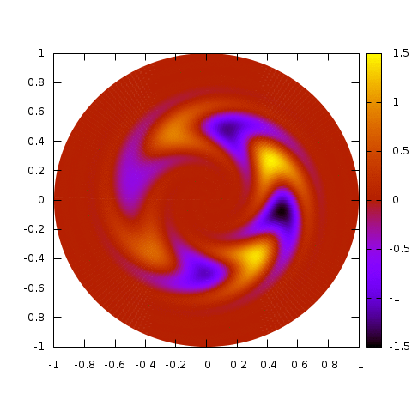
Superposition of m and m+1 harmonics generates ballooning mode structure
Ballooning structure: mode amplitude at the low-field side is larger than that of the high-field side
With radial phase variation: mode twist
Without radial phase variation

Slide 33
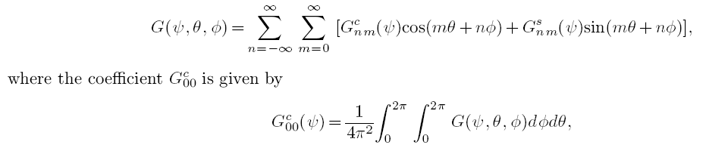
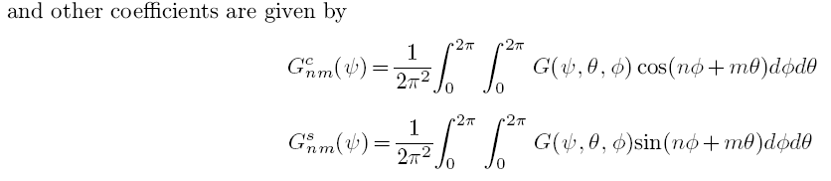
Two-dimensional Fourier expansion over poloidal and toroidal angle

Slide 34
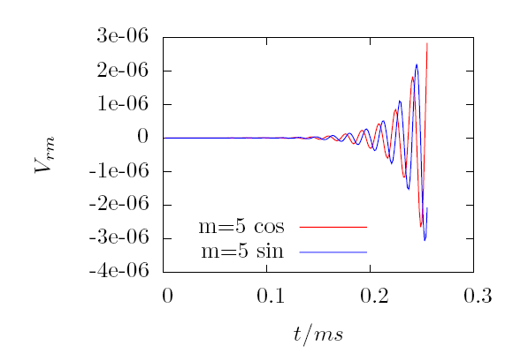
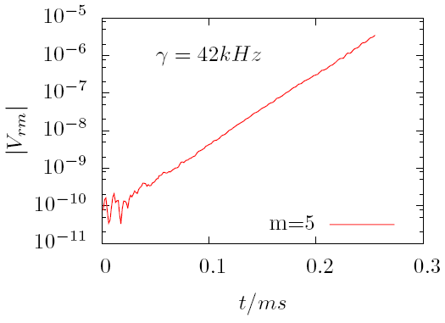
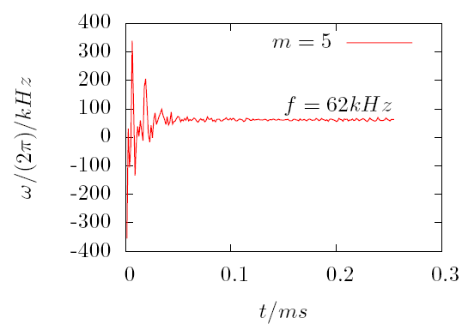
n=2

Slide 35
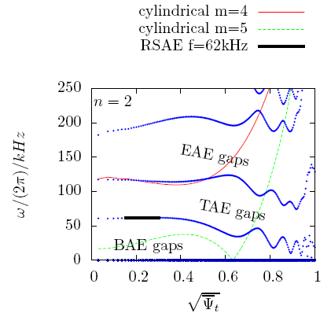
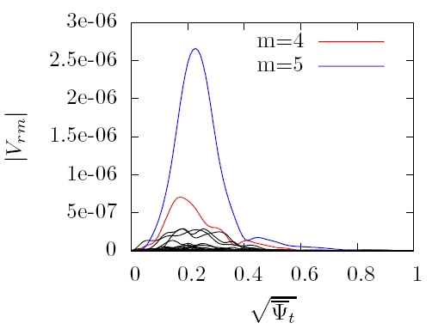
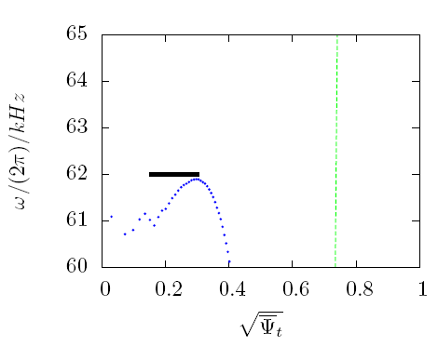
n=2 mode structure
This mode is a RSAE

Slide 36
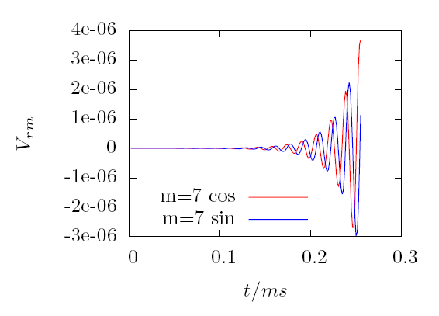
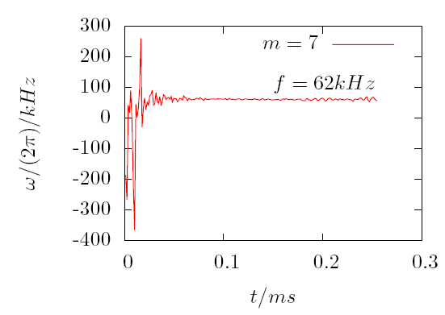
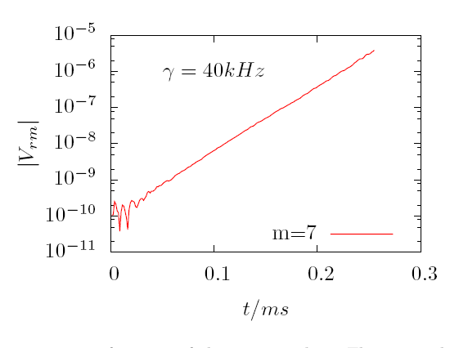
n=3

Slide 37
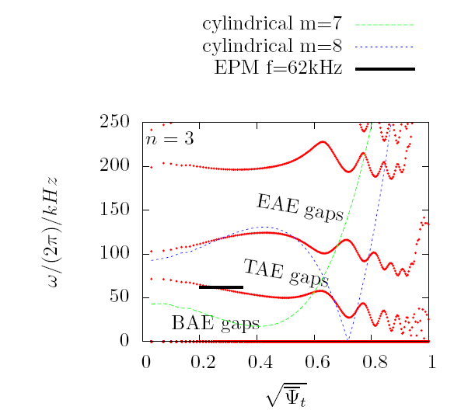
Location of n=3 mode on Alfven continua

Slide 38
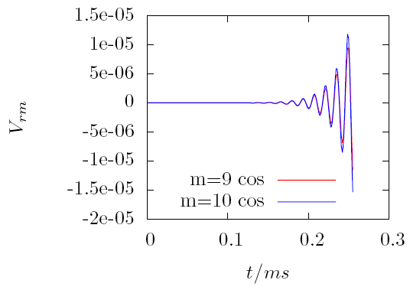
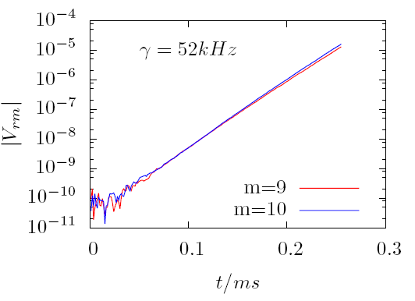
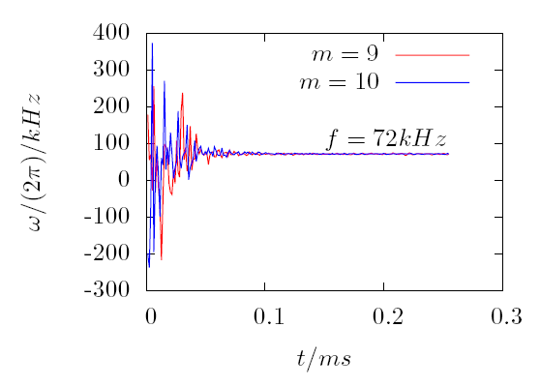
dd
n=4

Slide 39
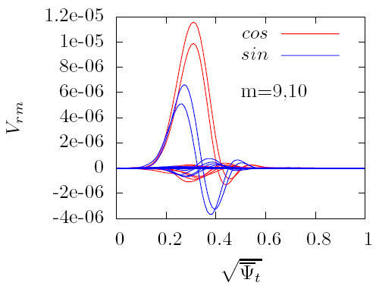
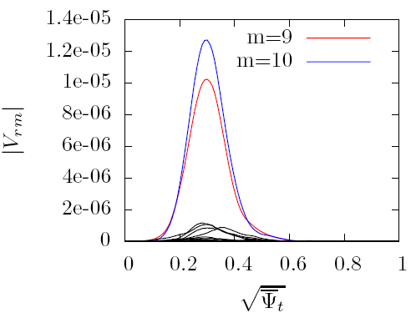
n=4 mode structure

Slide 40
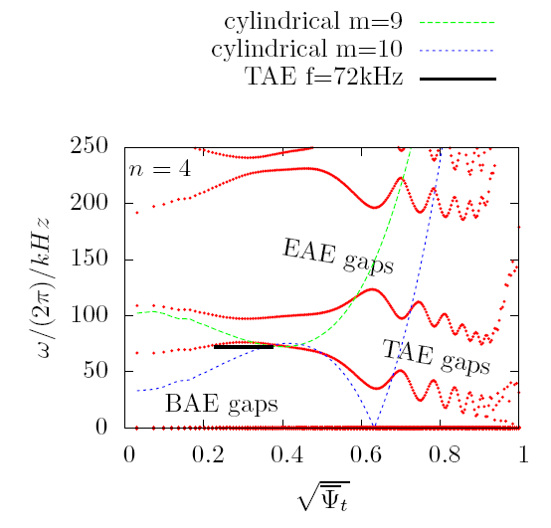
Location of n=4 mode on Alfven continua

Slide 41
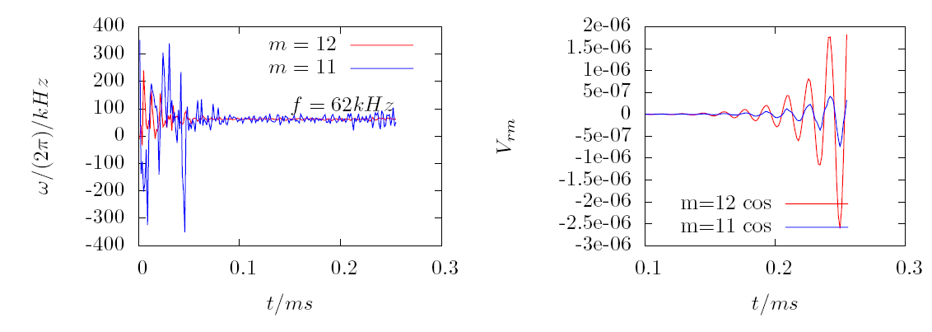
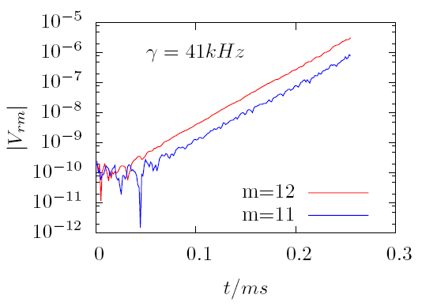
n=5

Slide 42
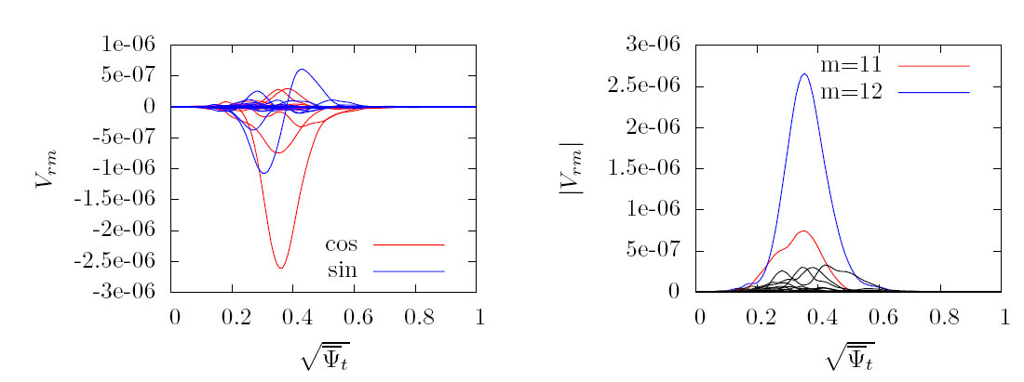
n=5 mode structure

Slide 43
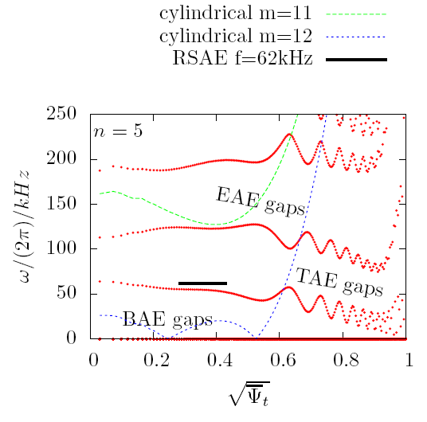
The location of n=5 on Alfven continua

Slide 44
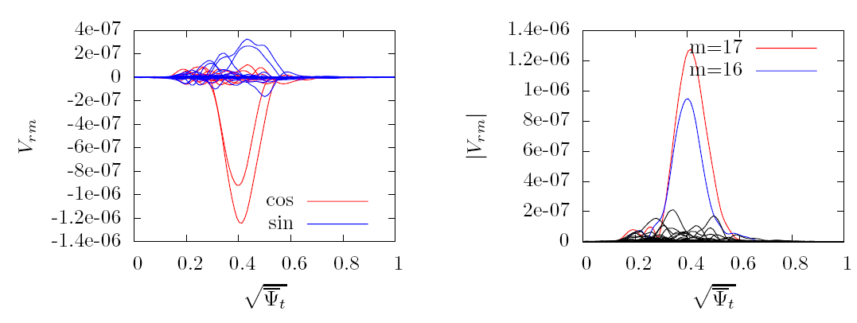
n=7 mode structure

Slide 45
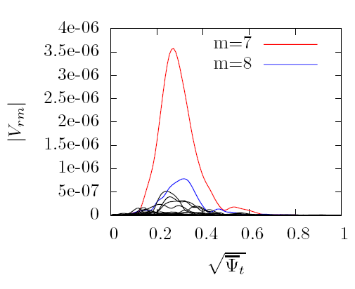
n=3 mode structure
This mode is an EPM

Slide 46
n=4 mode structure
This mode is a TAE

Slide 47
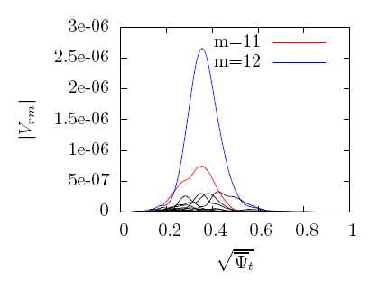
n=5 mode structure
This mode is a RSAE

Slide 48
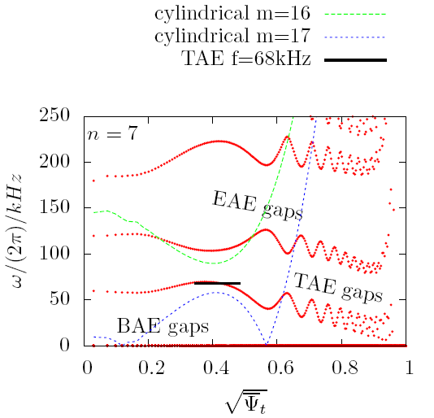
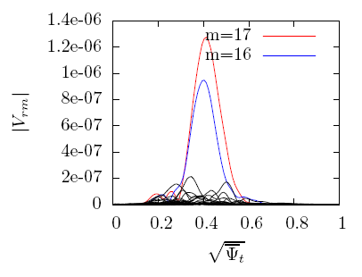
n=7 mode structure
This mode is a TAE

Slide 49

Radial structure of TAEs in EASAT #38300@3.9s

Slide 50

Two-dimensional structure of TAEs in EASAT #38300@3.9s
n=1, ballooling structure
m=1,2 TAE
m=2,3 TAE

Slide 51
Outline/Summary
Introduction
Modeling of fast ions: Kinetic theory
Modeling of main plasmas: MHD theory
Kinetic-MHD hybrid model
Examples of fast-ion-driven MHD modes: Alfven eigenmodes

Slide 52




Thank you
for your attention!
EAST – Test Bed for ITER & CFETR

